Slide 1
Virtual Zoo Guide
Final Design Review

Slide 2
Introduction
This project aims to provide a user the ability to view facts about all of the animals that can be found at the Hattiesburg Zoo. While the zoo does have its own website, ours will differ in that it will offer more facts than what the zoo offers, as well as provide a more direct format for viewing the factual information.
Notes:
Our project aims to provide users with the ability to view facts about all of the animals that can be found at the Hattiesburg Zoo. While the zoo does of course have its own website, ours will differ in that it will offer more facts about each animal as well as provide a more direct format for views those facts. The facts offered by the zoo’s own website are diet, status, and where the animal lives. Ours tries to cover the scientific name, endangerment status, diet, classification, region of living, environment type, active time of day, physical description, specific foods eaten, and fun facts.

Slide 3
High Level Requirements
The page should display a map with directions upon opening the application | Completed
The user should be able to open the map and the map shall load a list of the animals in that region of the map. | Completed
When an animal is selected from the list, it should display a new animal fact page with it’s fact and a photo. | Completed
When the user selects the animal, the map shall zoom in to show where the animal is in the map. | Completed
There shall be a search bar for the desired animal. Upon searching for one, the website should pull up every variety of the animal with that name. | Completed
When a region is selected from the map, the new page shall display a photo of which region the user selected with the list of animals. | Completed
When an animal is selected from the list, the map shall zoom in to the region of the animal. | Not-completed
There will be 'back' buttons on the animal list menu and the animal facts page that shall lead to the previous screen | Completed

Slide 4
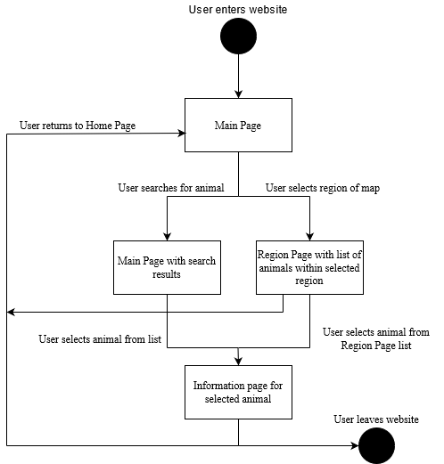
State Diagram

Slide 5
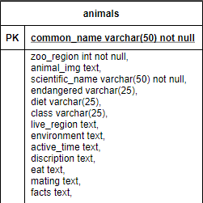
ER Diagram and Explanation
Our program works off a single table so there are not really any relationships.
Our program uses this table to select the information we need to display. Whenever information needs to be pulled from the database, we create queries to pull the relevant information we wish to display from the table.
For example, to display the animal names when the ‘Animals’ tab is selected, it selects only the common_name and iterates for each animal in the table. Then when an animal is selected from the list, a new query is made to only select that animal, then go through each attribute to style and print it to the screen.

Slide 6
Test Plan and Results
Given that there will be a database in addition to the website, our testing method will consist of a unit test which will cycle through the entire database and return positive for each entry if the information is successfully pulled and not null.
Web page is functioning via thorough manual usage.
Map itself will be manually tested by loading it onto a mobile phone screen to ensure appropriate scaling.
The search bar for the website will also be tested to ensure it navigates to the appropriate animals.
Notes:
Our first test of our test plan involves ensuring the integrity of the database. Now for this test, we opt for a unit test in the form of a Python script that queries each animal within the database and checks for any null information that could be absent. A pass would return if no null data is found.
As far as testing the website itself, we used manual testing in which each webpage would be visited, and the features would be tested by hand. The results will be passing if there were no broken features found.
The map on the website would be tested for proper scaling on a mobile device.
The search bar test we opted for a test in which random animals would be looked up and it would check if they were successfully navigated to. This test also considered a basic SQL injection attack that it would test to ensure that input was properly free of vulnerabilities.

Slide 7
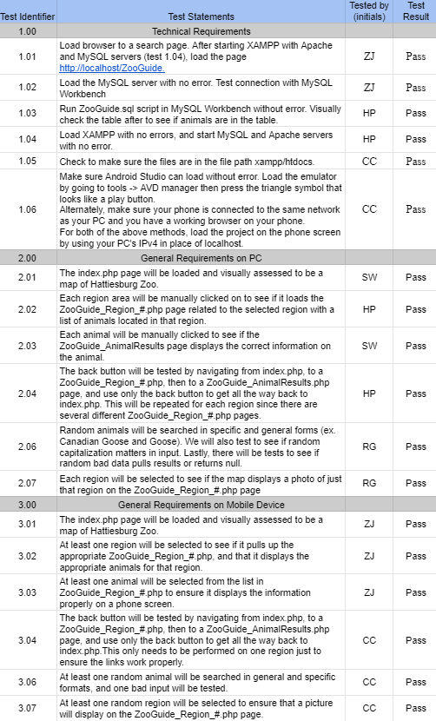
Test Plan and Results
Overview of each specific test.
Technical Requirements
General Requirements
General Requirements on Mobile Device.
Notes:
Here is an overview of each test that we put the site through. As you can see, each test was assigned to group members and the group member would sign off that the test passed or not.

Slide 8
Problems/Challenges
Creating a resizable version of the map which allows the map to adjust to whatever screen size it is on.
Researching and deciding which programming languages, applications, and IDEs to use that would work for this type of project.
The separation of work of the same product which leads to wasted time.

Slide 9
Missed Requirements
2.05 - When an animal is selected from the list menu, the map will zoom in to show where the animal is. This will be displayed by the animals information.

Slide 10
Questions?
Comments or other feedback is also welcome.

